Slide 1
Data Science Methods for Clean Energy Research
SVM
Feb 26, 2020

Slide 2
Outline
A brief note on the support vector machine
Comparison of supervised vs. unsupervised learning
Principal components analysis (PCA)
Clustering
Wrap up

Slide 3
Topics last time
Decision trees
Classification and regression trees
Tree depth and relationship to bias/variance concepts
Ensemble methods
Bagging
Random forest
Visualization of DTs
Big picture concepts:
DT can outperform regression or classification, especially when relationships are complex or nonlinear
DT are highly dependent on training data used, so ensemble methods are strongly advised

Slide 4
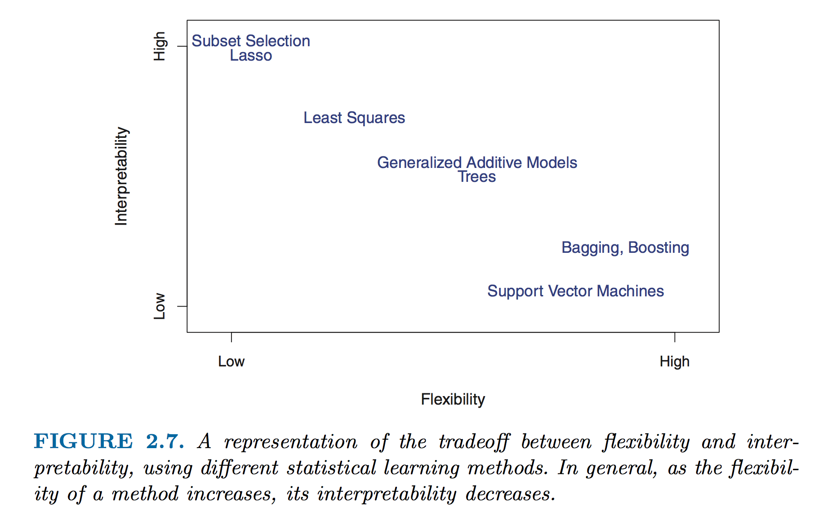
Flexibility and interpretability: Prediction and Interference
Notes:
Two basic ideals you are trying to achieve when making a model.
Parametric models typically are more interpretable, but aren’t as flexible.
Non-parametric models are more flexible, but less interpretable.
Why would you want a more flexible model? A more interpretable model?
Prediction: Given a new set of data, would we be able to use our model to predict outputs?. F(x) is a black box.
Inference: How do our inputs relate to our outputs? Interested in f(x)

Slide 5
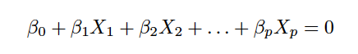
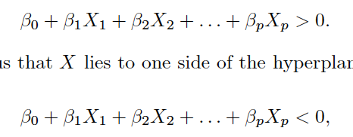
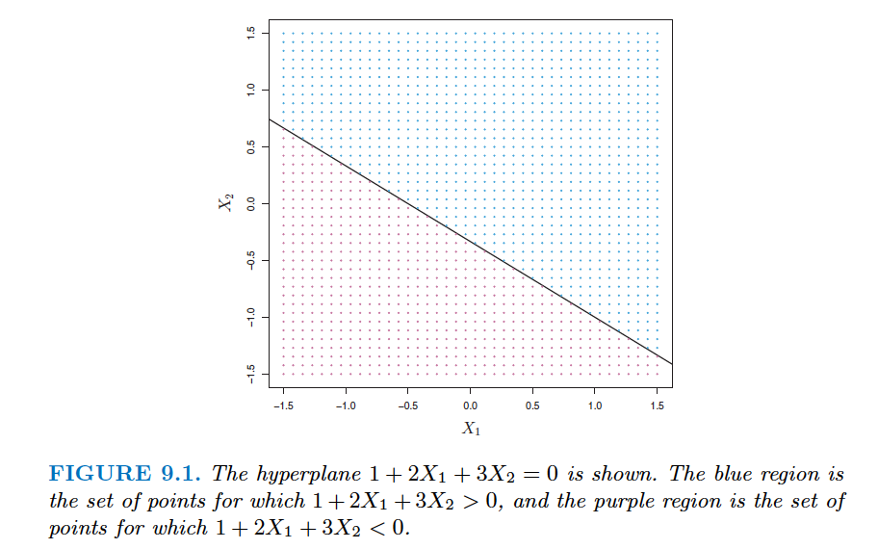
Classification Using a Separating Hyperplane
Recall that a hyperplane in a p dimensional space can be defined as follows
For any given point X = [X₁, X₂, …, X_{p}] we can determine what side of the hyperplane it is on via
How can we use this for classification?

Slide 6
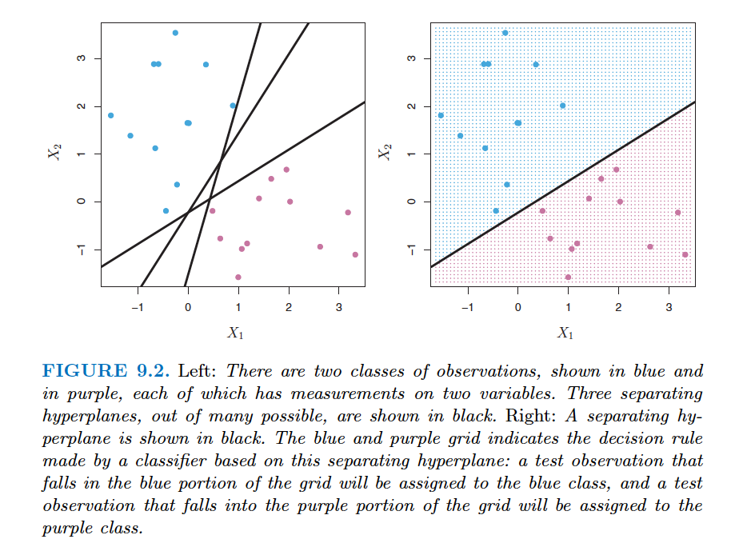
Classification Using a Separating Hyperplane
If we have p-dimensional feature, predictors, … then all we need to do is find a hyperplane that separates our classes
Easy, right?

Slide 7
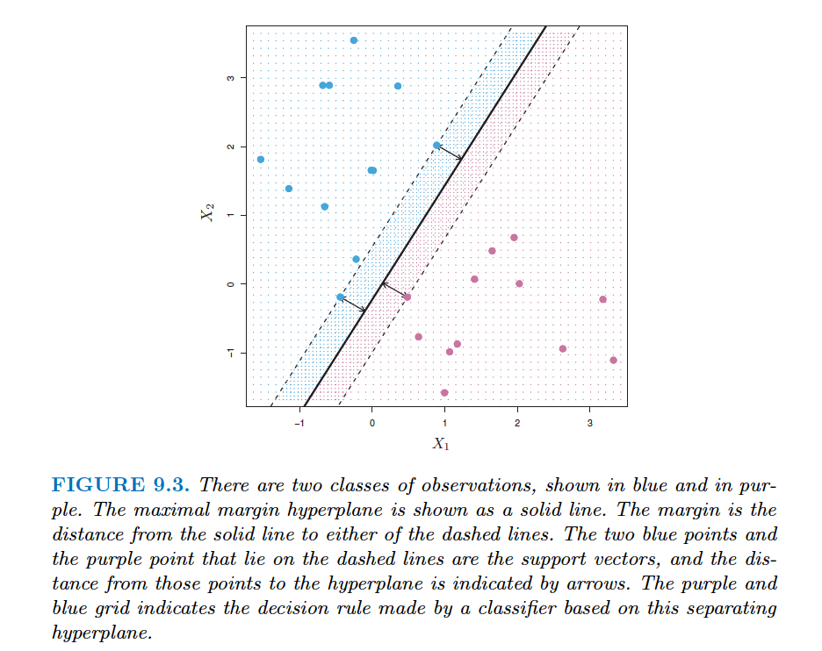
Maximal Margin Classifier
Hyperplane leads to linear decision boundary
Which hyperplane should be selected among many?
Maximal margin classifier
Choose the decision boundary that maximizes the (perpendicular) distance to points from both classes.
margin
We can think of margin as a measure of confidence in our prediction.

Slide 8
Maximal Margin Classifier
Hyperplane leads to linear decision boundary
Which hyperplane should be selected among many?
Maximal margin classifier
Choose the decision boundary that maximizes the (perpendicular) distance to points from both classes.
Support vectors:
They support the maximal margin hyperplane (other vectors are irrelevant)

Slide 9
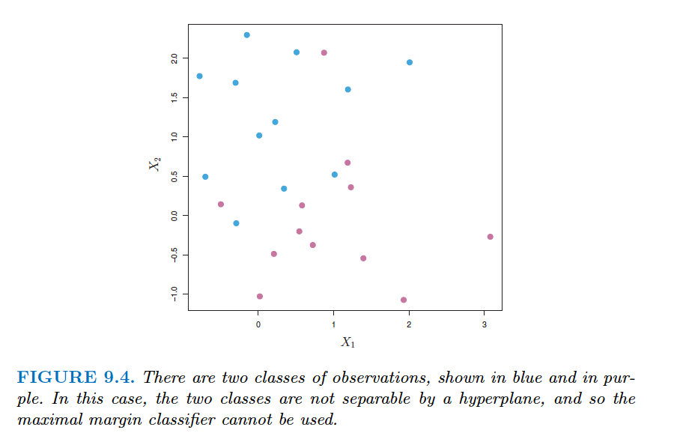
Support Vector Classifiers
What happens when no maximal margin classifier exists?

Slide 10
Support Vector Classifiers
What happens when no maximal margin classifier exists?
How to increase robustness to individual observations (correct classification of most of the training observations)?
Notice how sensitive the plane fitting is when add a new observation and don’t allow violations.
+1 point

Slide 11
Support Vector Classifiers
Solutions: we allow misclassifications within the margin.
Size of the margin is related to “budget” C, a parameter in our model.
The C parameter is the “budget” for the amount of points that can violate the decision boundary during training
When C is close to 0, no violates
As C increases, the extent of violates increases
Thus, C is our bias/variance tradeoff parameter
Algorithm:

Slide 12
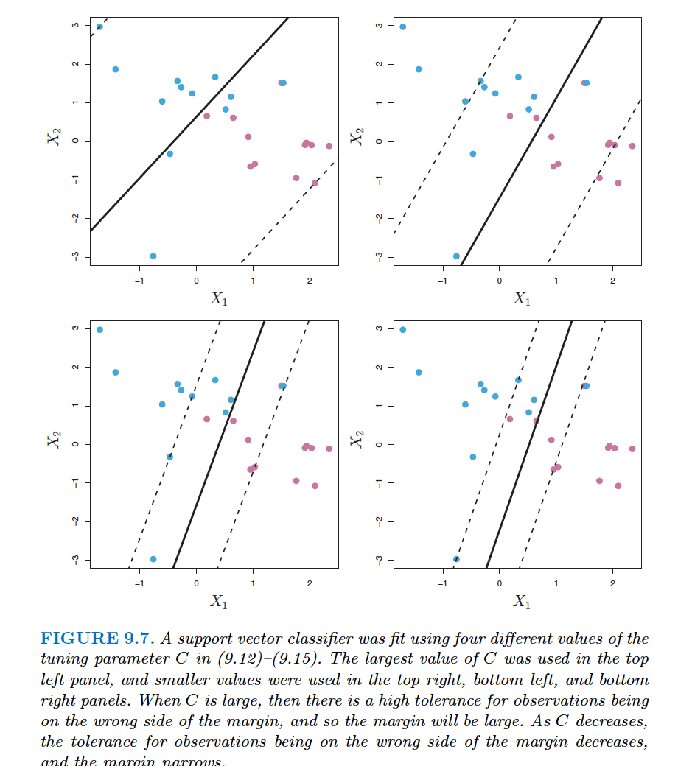
Support vector machine (SVM)
Example effect of C

Slide 13
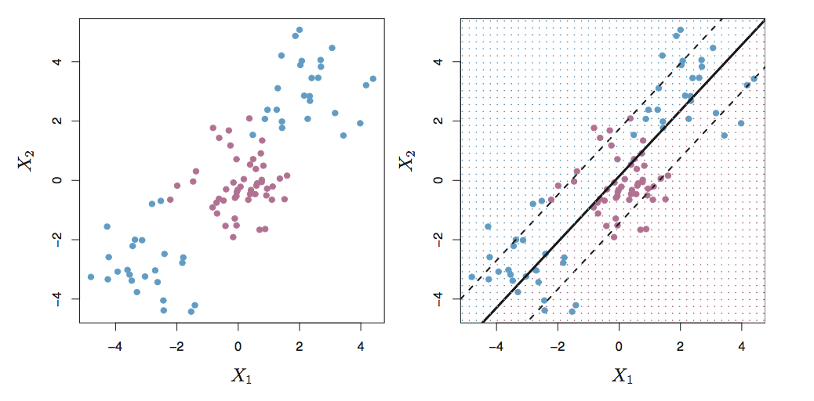
Support vector machine (SVM)
What happens when a linear boundary does not suffice?
Data from figs 9.8/9.9
2 features, 2 class
Linear boundary

Slide 14
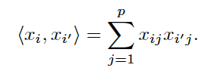
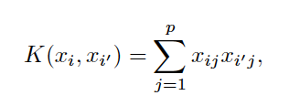
Support vector machine (SVM)
Include nonlinear terms in support vector classifiers
This idea can be generalized by kernels function K
Use a kernel function K that transforms the data into a higher dimensional space (i.e. more dimensions than p)
The kernel functions can be chosen such that they quantify the similar of two points in the higher dimensional space using only the inner product of the two points
$$β_{0}+β_{1}X_{1}+ …β_{p}X_{p} →β_{0}+β_{11}X_{1}+…+β_{1p}X_{p}+β_{21}X_{1}^{2}+…+β_{2p}X_{p}^{2}+…$$
Inner product
Linear kernel

Slide 15
Support vector machine (SVM)
Another visual example

Slide 16
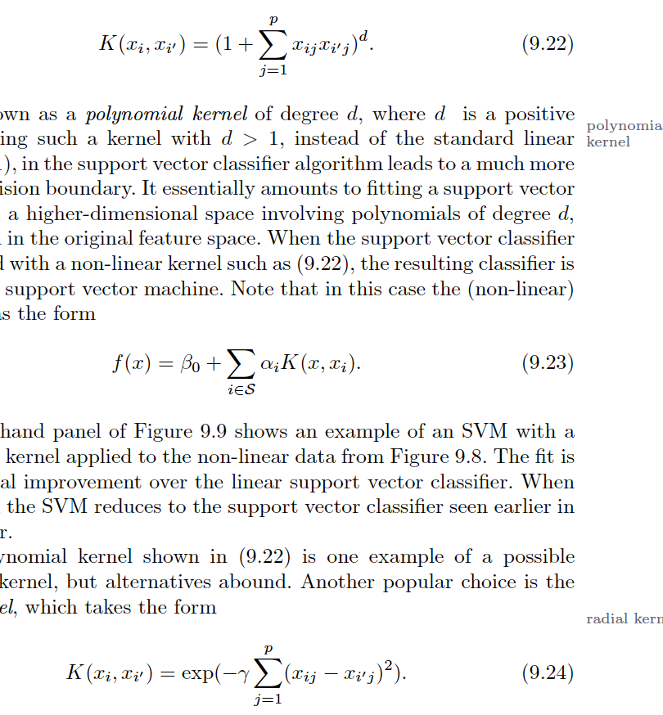
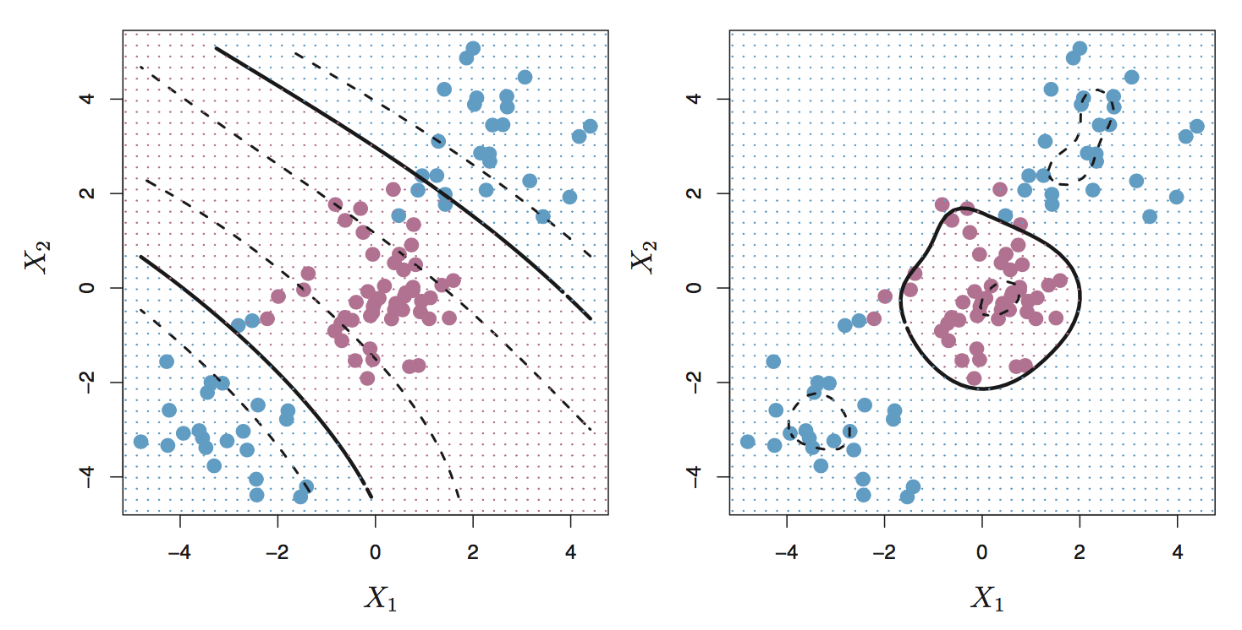
Support vector machine (SVM)
A non-linear kernel function turns the SVC into and SVM
More interesting kernels
Polynomial kernel
Radial kernel
SVM:
curved boundary
SVM:
radial boundary

Slide 17
Support vector machine (SVM)
Python time!
From sklearn website
http://scikit-learn.org/stable/auto_examples/classification/plot_classifier_comparison.html

